Slide 1

RUNGTA COLLEGE OF DENTAL SCIENCES & RESEARCH
TITLE OF THE TOPIC
DISEASES OF SKIN
DEPARTMENT OF ORAL PATHOLOGY & MICROBIOLOGY

Slide 2
GUIDED BY:-
DR SIDDHARTH PUNDIR
DR SUDHANSHU DIXIT
SKIN DISEASES

Slide 3
Specific learning Objectives
Core areas* | Domain ** | Category #
ECTODERMAL DYSPLASIA | COGNITIVE | MUST KNOW
LICHEN PLANUS | COGNITIVE | MUST KNOW
ERYTHEMA MULTIFORME | COGNITIVE | MUST KNOW
WHITE SPONGE NEVUS | COGNITIVE | MUST KNOW
PEMPHIGUS | COGNITIVE | MUST KNOW
Bullous pemphigoid | COGNITIVE | MUST KNOW
LUPUS ERYTHEMATOSUS | COGNITIVE | MUST KNOW
PSORIASIS | COGNITIVE | MUST KNOW
SYSTEMIC SCLEROSIS | COGNITIVE | MUST KNOW

Slide 4
ECTODERMAL DYSPLASIA
LICHEN PLANUS
ERYTHEMA MULTIFORME
WHITE SPONGE NEVUS
PEMPHIGUS
Bullous pemphigoid
LUPUS ERYTHEMATOSUS
PSORIASIS
SYSTEMIC SCLEROSIS

Slide 5
HEREDITARY HYPOHIDROTIC ECTODERMAL DYSPLASIA
Congenital dysplasia of 1 or more ectodermal structures
Manifested by hypohydrosis, hypotrichosis & hypodontia
Most common type
Abnormalities of skin, hair , nails , eyes, teeth, facies, sensorineural apparatus & adnexal structures

Slide 6
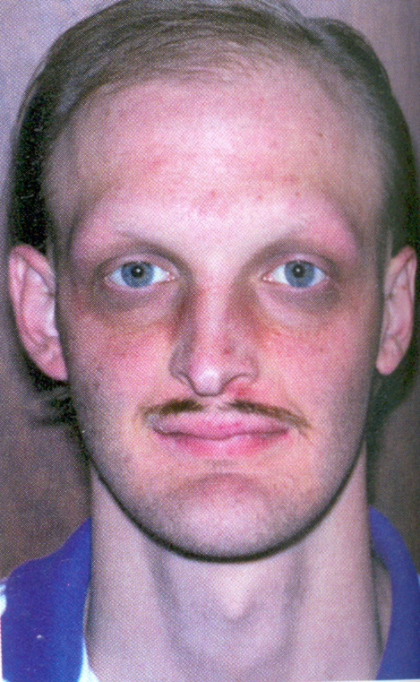
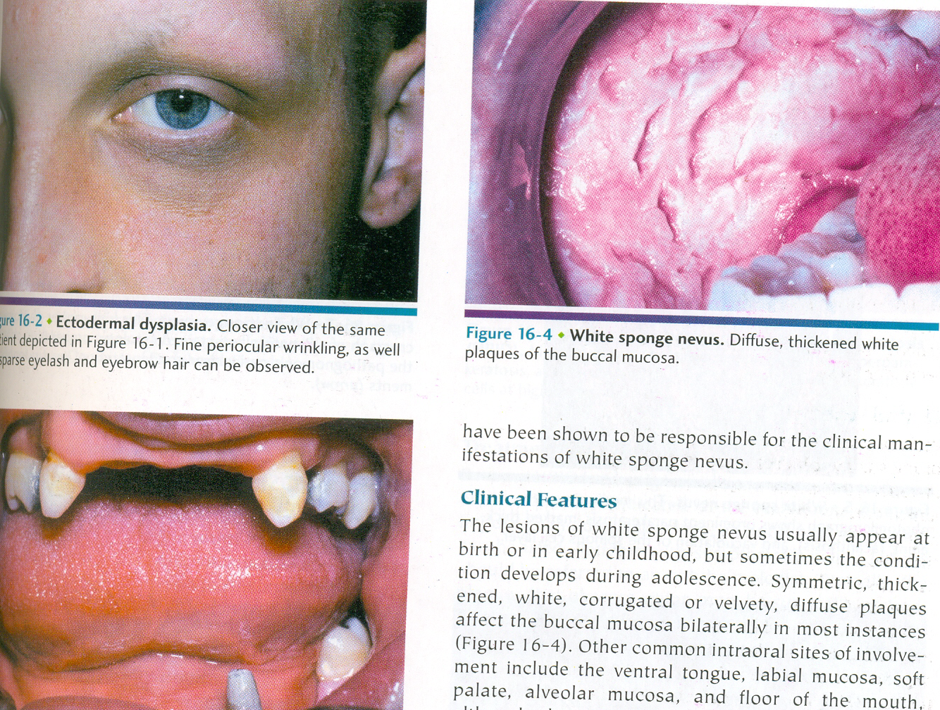

Slide 7
Oral manifestations
Anodontia or oligodontia
Frequent malformation of any teeth present in both dentitions
Cone shaped
Lips protuberant
High palatal arch
Palatal cleft

Slide 8
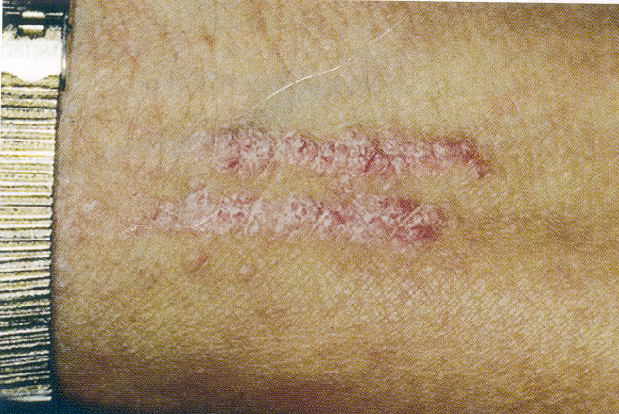
LICHEN PLANUS

Slide 9
Most common dermatological disease
Manifests itself in the oral cavity
Involvement of oral mucosa accompanies or precedes the appearance of lesion on the skin
EPIDEMIOLOGY
Indians—1.5%
3.7%
0.3%

Slide 10
CLINICAL FEATURES
F-M ratio -- 1.4:1
Small angular flat topped papules
Only a few mm in diameter
Discrete or coalesce into larger plaques
Covered by fine glistening scales
Initial lesion – red in color which take on a reddish, purple or violaceous hue

Slide 11
Advanced lesions- dirty brown color develops
Centre slightly umbilicated
Surface covered by fine grayish white lines called WICKHAM’S STRIAE
Bilateral symmetrical pattern
On flexor surface of wrist & forearms, inner aspect of knees & thigh & the trunk

Slide 12
ORAL MANIFESTATIONS
Radiating white or gray velvety thread like papules in a linear, reticular arrangement forming typical rings or streaks over the buccal mucosa
A tiny white elevated dot present at the intersection of white lines called STRIAE OF WICKHAM

Slide 13
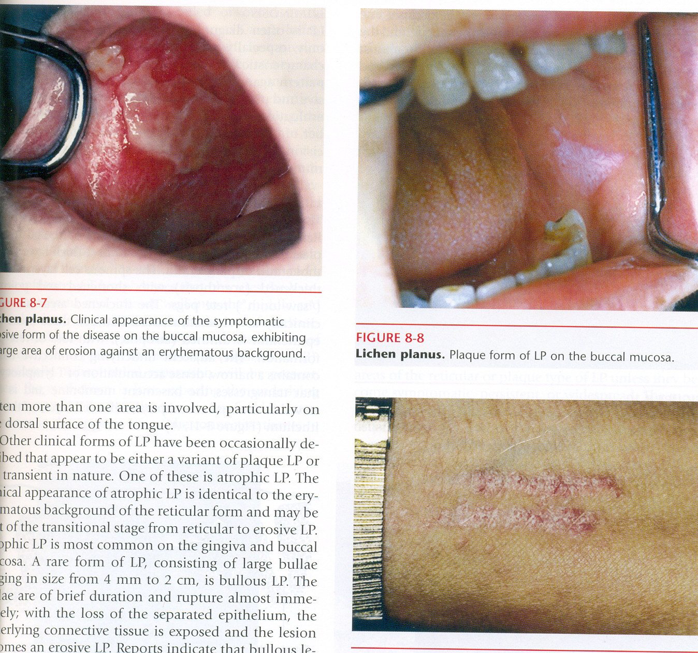
PLAQUE FORM
EROSIVE FORM

Slide 14
ERYTHEMA MULTIFORME
Blistering ulcerative mucocutaneous condition
Minor
Major - SJS
Uncertain pathogenesis
Preceding infection -herpes simplex mycoplasma pneumonia, histoplasmosis - Exposure to drugs
GI- Crohn disease, ulcerative colitis
Others- malig, radiations, vaccinations

Slide 15
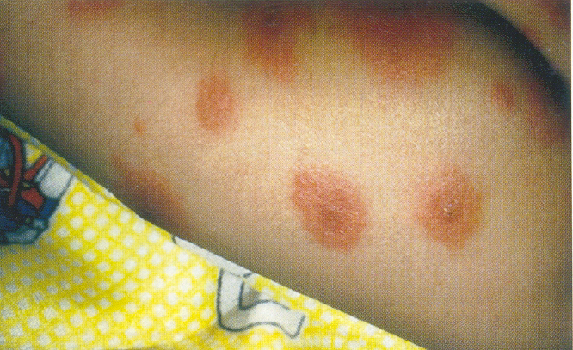
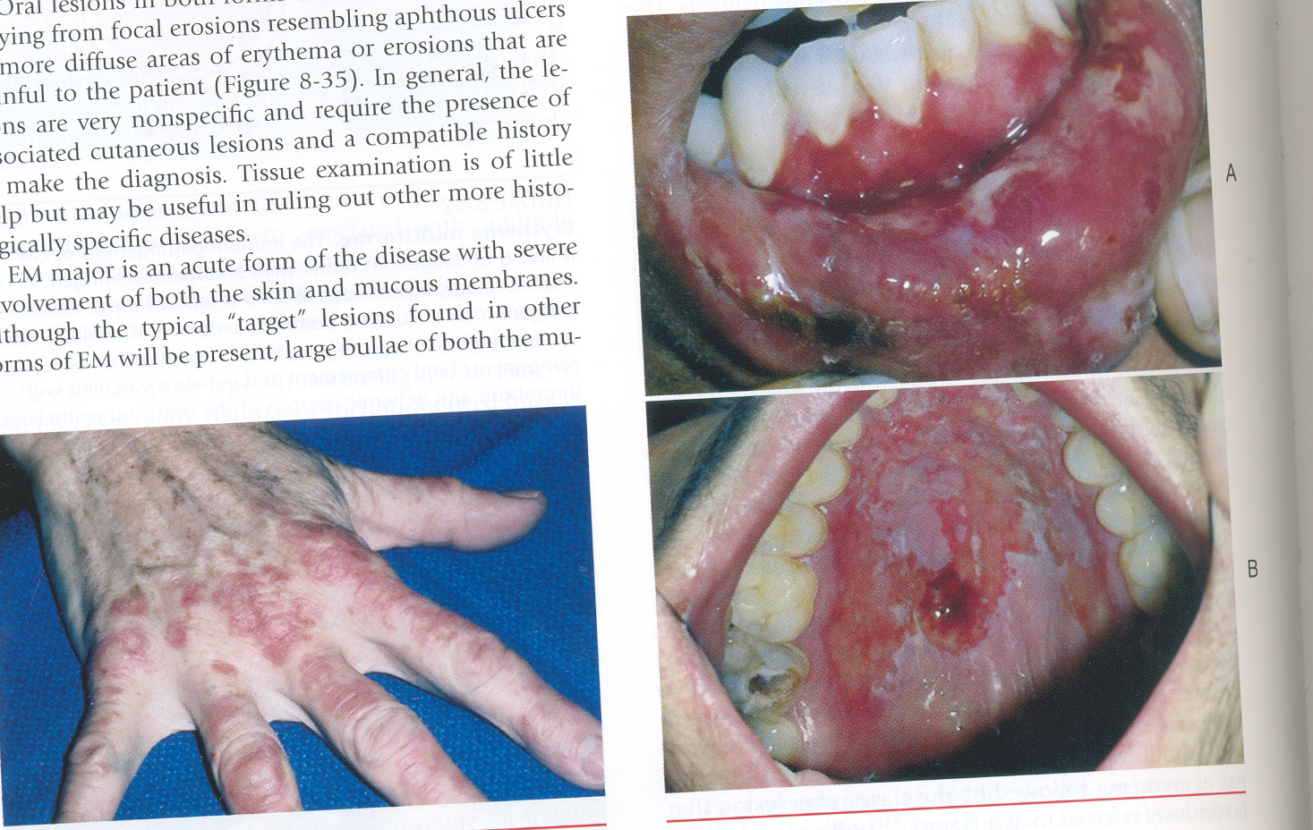
TARGET LESIONS

Slide 16
STEVENS JOHNSONS SYNDROME
Severe bullous form of Erythema multiforme
Involvement of skin, oral cavity, eyes & genitalia
Triggered by drugs rather infection
Fever, malaise, photophobia, eruptions

Slide 17
WHITE SPONGE NEVUS- Cannon’s disease
Rare genodermatosis
Inherited as an AD trait
No definite sex predilection
Defect in normal keratinization of oral mucosa
Mutation in keratin genes

Slide 19
PEMPHIGUS
Chronic skin disease characterized by
appearance of vesicles and bullae.
Autoimmune mechanism is involved
Types:
Pemphigus vulgaris ] Oral mucosa
Pemphigus vegetans ] Oral mucosa
Pemphigus foliaceus
Pemphigus Erythematosus

Slide 20
CLINICAL FEATURES
Before 30 yrs of age
Both males and females
PEMPHIGUS VULGARIS
Vesicles and bullae
Few mm to cms
Contain fluid
Raw eroded areas

Slide 21
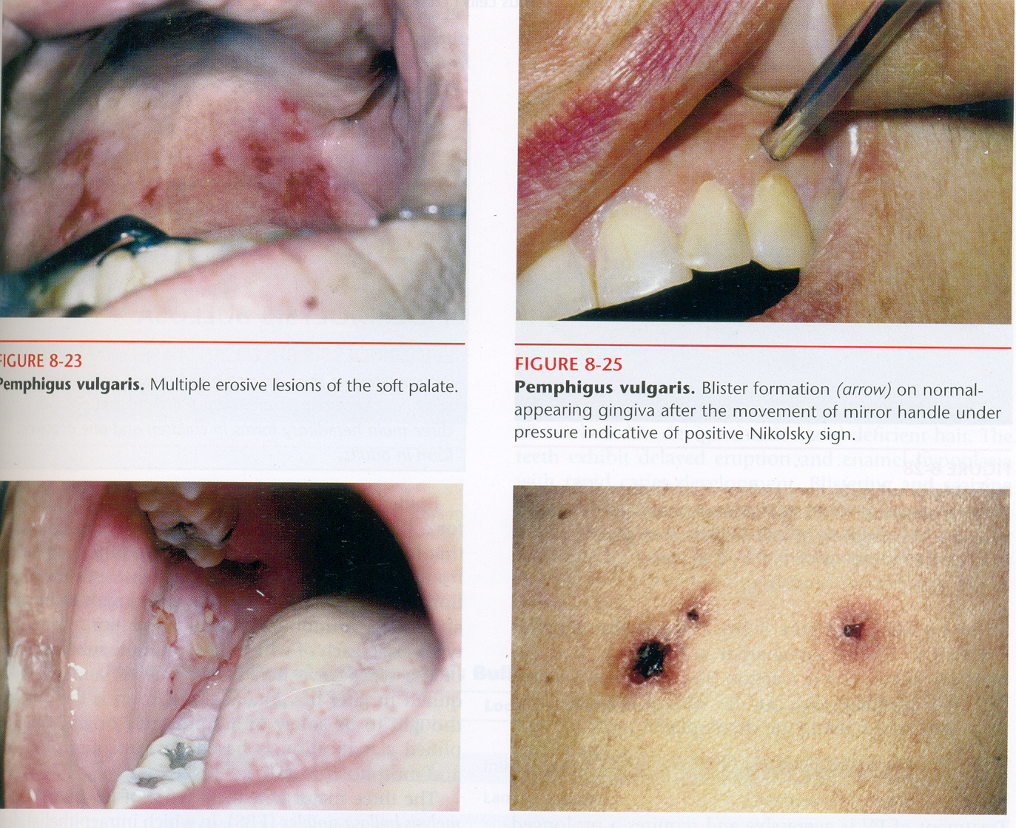

Slide 22
Oral manifestations
MM affected first -50-70%
Palate, labial mucosa, buccal mucosa, ventral tongue & gingivae
Erosions extend periphery with shedding of epithelium
Any part of OC
Larynx-hoarseness
uncomfortable

Slide 23
CICATRICIAL PEMPHIGOID
(BENIGN MUCOUS MEMBRANE PEMPHIGOID)
Represents a group of chronic blistering mucocutaneous autoimmune disease in which tissue bound autoantibodies are directed against one or other components of basement membrane
Cicatrix means “scar” of conjunctival mucosa

Slide 24
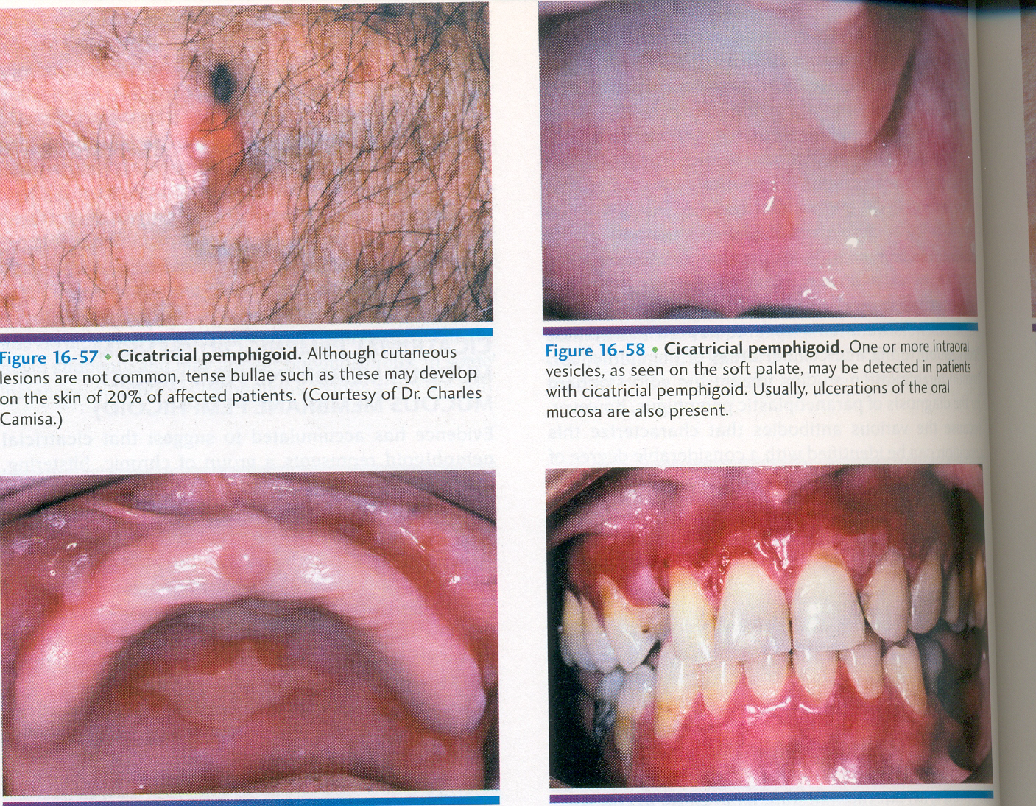

Slide 25
Bullous pemphigoid (Parapemphigus)
Bullous pemphigoid is characterized by the production of autoantibodies directed against the components of basement membrane
Resembles Cicatricial pemphigoid

Slide 26
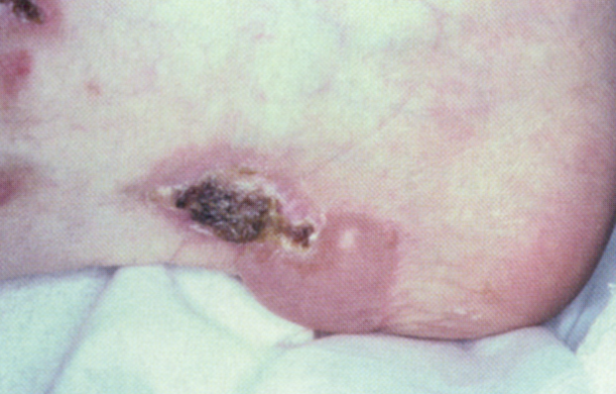

Slide 27
LUPUS ERYTHEMATOSUS
Common disease of unknown etiology
Immunomediated condition
Common collagen vascular or C.T disease
Two types
Systemic lupus erythematosus (SLE)
Discoid lupus erythematosus (DLE)

Slide 28
Systemic lupus erythematosus (SLE)
Serious multisystem disease with cutaneous & oral manifestations
Immune dysfunction – damage to organs
ONSET -30 years in females & 40 years in males
F:M ratio – 8:1 2:1 & 4:1

Slide 29
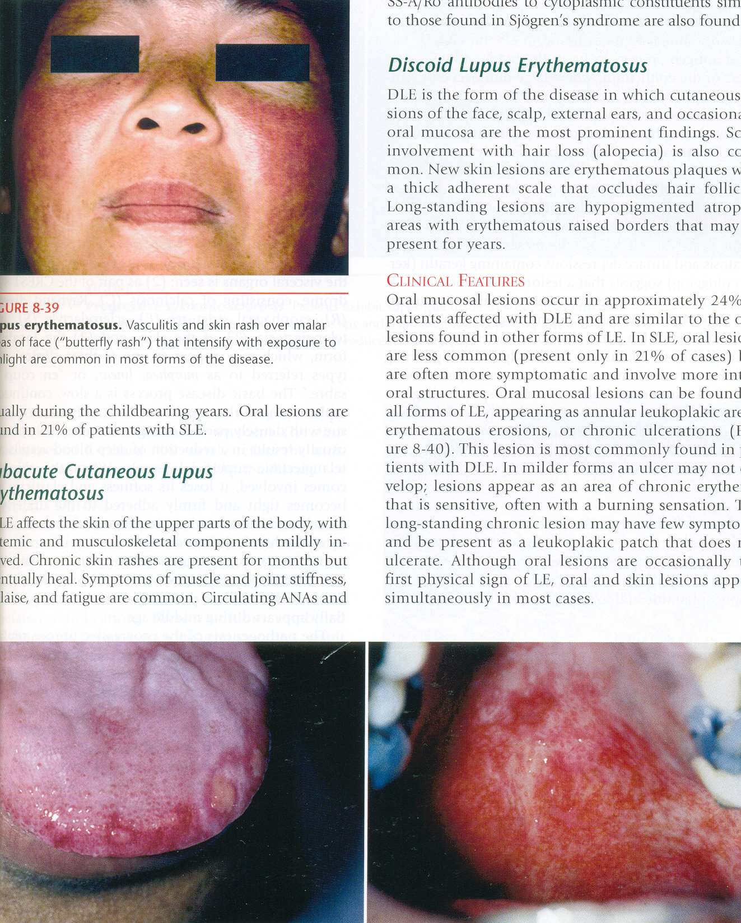
Butterfly rash

Slide 30
Discoid lupus erythematosus (DLE)
3rd & 4th decade of life
More in women
Common sites – face, oral mucous membrane, chest, back & extremities
Chronic

Slide 31
Oral mucosal lesions of tongue & palate

Slide 32
PSORIASIS
Common chronic skin disease of inflammatory origin with occasional oral manifestations
Noncontagious skin disorder
Inflammed, edematous – silvery white scales

Slide 33
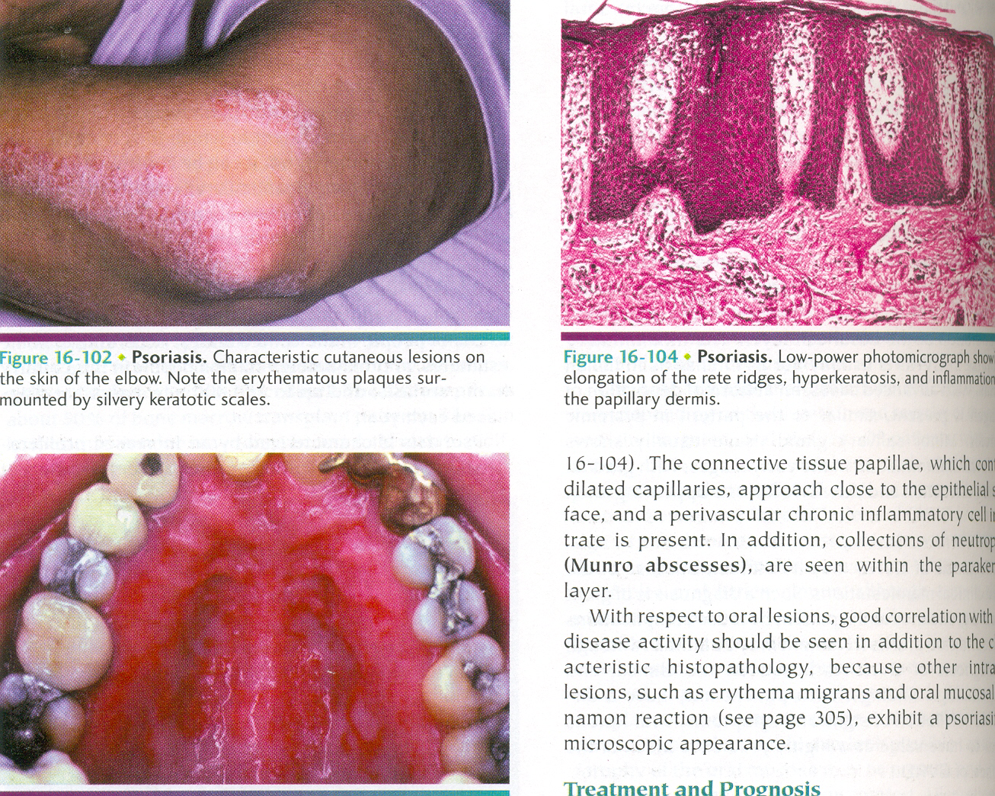

Slide 34
Oral manifestations
Rare
May present as leukoplakia or lichen planus
Lips, buccal mucosa, palate, gingiva &
Floor of the mouth
Oral lesions similar to skin lesions

Slide 35
Epidermolysis bullosa
Inherited disorder – blister formation
EB Simplex
Junctional EB
Dystrophic EB
HEB

Slide 36
Oral manifestation
20%
Oral milia
Teeth unaffected
H/P
Irregular PAS positive BM – Divided
Basal layer normal
No elastic & oxytalan fibres

Slide 37
SYSTEMIC SCLEROSIS
(SCLERODERMA)
Relatively rare condition
Immunologically mediated pathogenesis
Characterized by dense collagen deposition in tissues of the body in extraordinary amounts
Skin & most organs of the body are affected

Slide 38
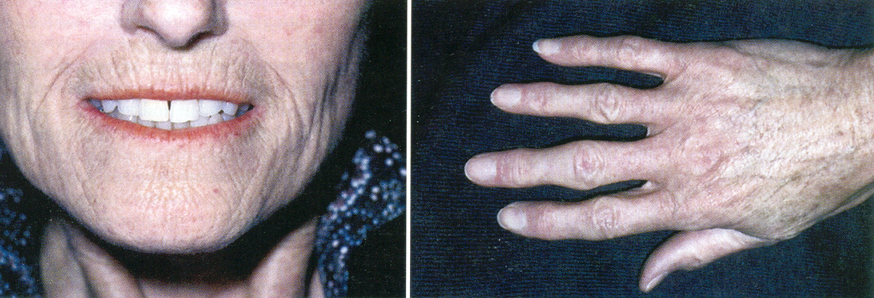

Slide 39
CREST SYNDROME
CALCINOSIS CUTIS
RAYNAUD’S PHENOMENON
ESOPHAGEAL DYSFUNCTION
SCLERODACTYLY
TELANGIECTASIA
Circumscribed - morphea
Linear – coup de sabre

Slide 40
Take home message
Most common skin disease include acne, blocked skin follicles that can lead to oil, bacteria and dead skin builder in your pores

Slide 41
Question & Answer Session
ORAL MANIFESTATION OF LICHEN PLANUS
STEVEN JOHNSON SYNDROME
PEMPHIGUS
CLASSIFY PEMPHIGOID
SLE
CREST SYNDROME

Slide 42
REFERENCES
NAME OF THE BOOK WITH EDITION AND PAGE NUMBERS
ARTICLE ARE TO BE MENTIONED IF NEEDED
SHAFER’S 9th EDITION
LUCAS
NEVILLE
REGEZI

Slide 43
THANK YOU

